Slide 1

Are Children your business?
© UNICEF/NYHQ2006-1500/Pirozzi

Slide 2
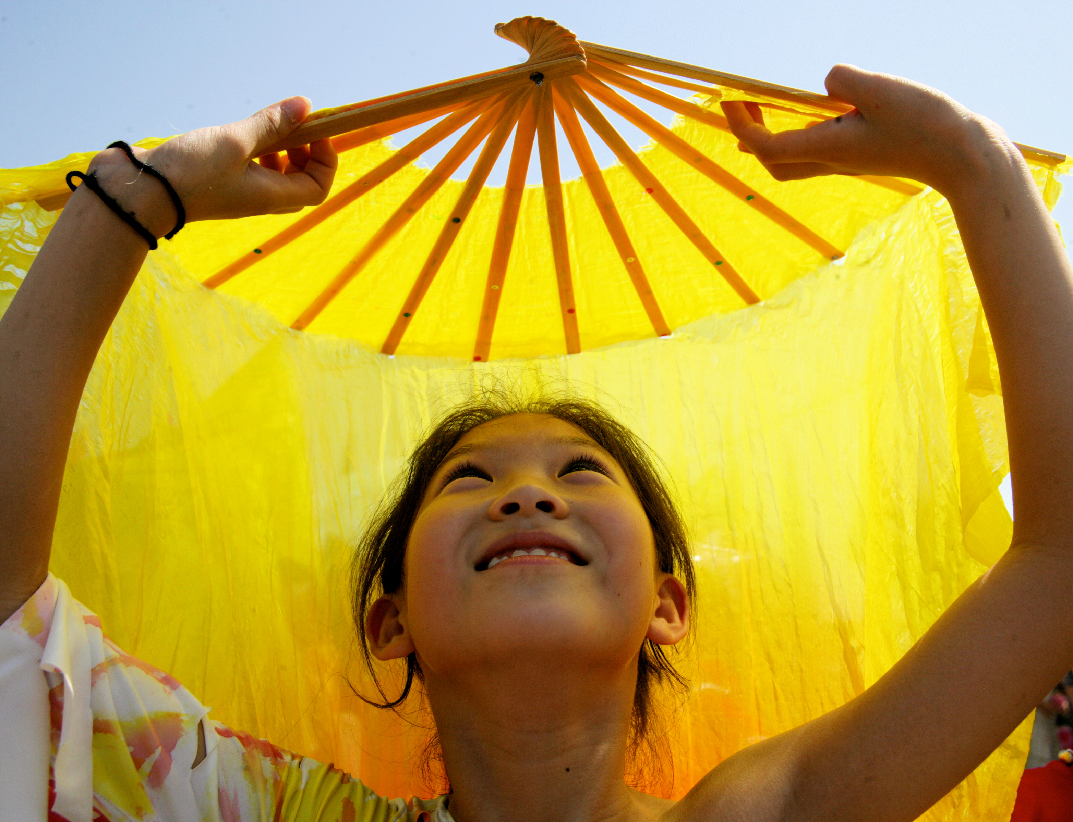
© UNICEF/NYHQ2006-2918/Pirozzi
UNPACKING CHILDRENS RIGHTS ISSUES

Slide 3
KEY FINDINGS: FRAMING OF CHILD LABOUR ISSUES IN THE FORMAL AND INFORMAL GOLD MINING SECTORS OF BUSIA, MOROTO AND NAKAPIRIPIRT DISTRICTS
© UNICEF/NYHQ2006-1500/Pirozzi

Slide 4

Child labour: a global and local challenge
Child labour is a global prevalence across sectors
1 in 5 children aged 5-17 engaged in child labour
Particularly adverse impacts in the mining sector due to hazardous tasks

Slide 5
Work: No Child’s Business (WNCB) Program
Collaborative Initiative to Eradicate Child Labour
Global Alliance: UNICEF, Save the Children, Stop Child Labour
Goal: Eradicate child labour by 2025
6 focal countries - Mali, Cote D’Ivoire, India, Jordan, Vietnam, and Uganda
Empowering children: Quality education, decent work opportunities
SDG alignment: Contributing to Sustainable Development Goal (SDG) 8.7
WNCB Alliance in Uganda
Local Alliance: HIVOS, UNATU, NRDO, EWAD, Save the Children International
Targeted regions: Nakapiripirit, Moroto, Busia districts
4 Pathway Approach: Community, Government, Private sector, International collaboration
Currently strengthening the local front to eradicate child labour

Slide 6
Private sector: pathway 3
The Private Sector takes full responsibility for preventing and addressing child labour

Slide 7
Key Study Objective
Assess the prevalence of child labour in the Gold mining sector at community level.

Slide 8
Scope of study
Geographical Areas covered
Respondent Groups
Busia District: Busitema, Buteba, Tiira Town Council sub-counties
Moroto District: Nakabaat, Nanyidik, Kosiroi sub-counties
Nakapiripirit District: Utut, Acherer, Lokeruman sub-counties
National Level: Respondents in Kampala
 | Respondent Groups | #s
1 | Children through FDGs | 22
2 | Youth, Parents, mentors and teachers through FDGs | 27
3 | DLG officials through key informant interviews | 11
4 | CSO’s through key informant interviews | 29
5 | Artisanal and Large mining associations through key informant interviews and observations | 14
6 | MDAs through key informant interviews | 1
7 | National business/mining associations through key informant interviews | 5
8 | ASM and LGSM sites observed | 5
9 | Funding and technical partners through key informant interviews | 9
Total |  | 123

Slide 9
Key Findings

Slide 10
Varied Awareness levels of child labour
CSOs exhibit comprehensive understanding of the subject
Minority of private sector entities aware of laws against child labour (CSO initiatives drive policies)
ASMs recognize child labour existence but lack awareness of laws and regulations
LGSMs acknowledge indirect impacts, emphasize children's employment prohibition.
Confusion between child labour and light/child work

Slide 11
Causes of child labour …[1/2]
Poverty a compelling driver:
  Need for survival drives children into workforce
  Lokiru Paul from Utut community: Willingness to work for chances of survival
  FGD insight from Acherer: Mining for essentials like books, food, clothes
Peer pressure influence:
  Older children aged 12-17 motivate younger peers to mine
  Prior earnings from mining serve as motivation
Child-headed households and vulnerable children:
  Orphans and children in child-headed households vulnerable
  Engage in labour-intensive tasks due to lack of guardianship

Slide 12
Causes of child labour …[2/2]
Exploitation: Cheap labour perception:
  Private sector exploiting children for inexpensive labour
  Children engaged under the guise of light work
School dropouts enticed:
  School dropouts prefer mining over idleness
  A parent in Busia: Son dropped out, opted for mining
Food insecurity [Karamoja]
  Karamoja region's food insecurity due to drought
  Hunger crisis drives children to gold mining for sustenance
  Cattle rustling worsens child labour as families seek survival

Slide 13
Consequences of child labour …[1/2]
Health Hazards
  Children in charcoal burning
  Health risks - physical strain, exposure lead to headaches, chest pain
  Gold mining in water increases pneumonia risk
  Sanitation and hygiene deficiencies: drinking water sourced from river sand and absence of latrines worsens conditions
Education is compromised
  Lack of time for studying, learning disruption
Social challenges
  Rampant alcohol consumption.
  Lack of law and order fosters violence.
  Criminal elements find refuge.

Slide 14
Consequences of child labour …[2/2]
Exposure to Peril and Emotional Strain
  Dangers like snake encounters
  Cattle herding exposes to raiders, abduction risk
  Accidents during mining result in injuries, fatalities - Example: Child buried in soil while digging pit
  Harassment and Exploitation - Emotional strain from forced labour leads to annoyance
  Exploitation for meagre gains, insufficient to sustain needs
  Lack of protective gear
Sexual Exploitation and Reckless Lifestyle
  Girl child vulnerable to early marriage, rape, STDs/STIs
  Child labour linked to alcoholism, substance abuse, lawlessness
  Parents distressed by children's suffering, injuries

Slide 15
Challenges faced in addressing child labour
Despite community efforts, child labour in gold mines persists
  Children introduced into mining operations illicitly.
  Tasks like fetching water, cleaning, carrying stones, and cooking constitute child labour.
  Notable sites: Rupa, Nakabaat, Lotakero in Moroto District.
Disparity between Policy and Reality
  Child involved in washing activities Greenstone Resource Company in Busia, despite policy against child labour.
  Policy implementation gap evident.
  Artisanal sites in Syanyonga village and Angorom notably employ children in various tasks.
Limited efforts against child labour.
  ASMs focus on member welfare.
  Incomplete understanding of private sector's role.
  Persistent engagement of children in labour due to lack of policies and conditions.
Complex reality of poverty

Slide 16
Children in the Gold value chain
 | ASMs | LGSMs
Exploration and Prospecting | Traditional methods, local knowledge, geological surveys. | Exploration and Prospecting: Advanced techniques - surveys, remote sensing, drilling.
Mining and Extraction | Manual techniques, panning, digging, limited mechanization. | Mining and Extraction: Modern methods, open-pit or underground mining, advanced technology.
Ore Processing: | Manual crushing, grinding, gravity separation. | Ore Processing: Elaborate techniques - crushing, grinding, gravity separation, cyanide leaching.
Gold Refining: | Simple methods like heating, mercury amalgamation. | Gold Refining: Collaboration with refineries to achieve desired purity levels
Child involvement | Direct involvement at multiple stages of ASM value chain. Tasks: tunnel digging, washing, sieving, water fetching, cooking, mercury use. Child participation in gold sale to intermediaries, often leading to exploitation | Contrary findings - children involved in some large-scale mining activities. Activities: sorting stones, clearing excavated areas based on gold traces. Impact on family well-being: subpar working conditions, inadequate wages, lack of social services, exposure to adverse social circumstances

Slide 17
Gold market Roadmap […1/2]
Busia, Nakapiripirit, and Moroto: Crucial gold trading hubs in Uganda
  Local gold market serves as a link for artisanal miners and various market players.
  Intermediaries bridge the gap between miners and the broader gold market.
Tier of Gold Mining Traders
  Smaller traders within communities procure gold.
  Middlemen aggregate gold from smaller traders for larger transactions.
  Middlemen often connected to LSGM companies or refineries.
  Price influenced by quality, quantity, and exchange rate.
Gold Flow from Community to International Markets
  Gold leaves community for larger dealers in Kampala.
  Transition to LSGM firms or global refiners.
  Exported to international destinations like Dubai and India.
  Large-scale mining firms adhere to strict licensing and regulatory requirements

Slide 18
Gold market Roadmap […2/2]
Distribution in the Global Gold Market
  Large-scale mining enterprises act as exporters, collaborate with global partners.
  Gold reaches wholesalers, refiners, jewellery manufacturers.
  Products include bars, coins, jewellery, and investments.
  Distributed through stores, dealers, financial institutions, serving end users.
Challenges in the Local Gold Market
  Absence of accurate testing machinery leading to fraud.
  Market volatility due to international price fluctuations.
  Competitive dynamics favour larger dealers, impacting smaller traders.
  Regulatory challenges due to the informal nature of the market.

Slide 19
PUBLIC SECTOR Interventions against child labour
Programs and initiatives by CSOs
  Work: No Child’s Business (WNCB) consortium leads efforts in Busia and Karamoja.
  Stop Child Labour project (2016-2019) in Busia involving SOLIDARIDAD, Fairphone, Phillips, and EWAD.
  Child Labour-Free Zone (CLFZ) model by EWAD, counselling, school reintegration, and business improvement.
  UNICEF Uganda's CRBP project in Busia raising awareness about child rights' impacts.
Mineral police, para social workers, child protection committees
  Site inspections, Identification of underage workers, education advocacy.
  Example from Mineral Police Officer's statement in Nakapiripirit District
Motivational centres in Busia aid reintegration into formal education
  Centres promote sensitization, guidance, counselling, skill-building.
  Significant role in redirecting children away from child labour.
Community sensitization and mobilization
  Mentors, teachers, social workers under WNCB engage in community sensitization.
  Focus on parents, highlighting risks associated with child labour.
  Active mobilization by community leaders against child labour in Busia and Karamoja
Skill development and Vocational Centres
  World Vision (Busia) and SOMERO Uganda (Karamoja) establish skill-oriented centres.
  Programs empower children and parents, tackling child labour.
  Emphasis on skill acquisition, offering alternatives to child labour

Slide 20
Private sector initiatives against child labour
Collaborations and Sensitization efforts
  WNCB collaborates with private sector in Moroto, raising awareness on child labour.
  Collaboration with Tororo Cement to eliminate child labour, providing support to vulnerable children.
  Save the Children sensitizes private and public sectors in Karamoja on CRBP, inspecting premises to curb child labour.
Partnerships for Prevention and Awareness
  CRBP consortium partners with sunbelt company, ceasing child labour and prevention efforts.
  Collaboration with the International University of East Africa for child well-being in Nakapiripirit.
  AGROMAX's efforts to end child labour in Karamoja's agricultural fields.
Private Sector Policies and Commitments
  Greenstone Resources Limited's proactive policy against child labour.
  VSLAs supporting family well-being and education against child labour.
  Busia United Mining Company's policies, sensitization, and support for child education.
Promoting Responsible Sourcing and Supply Chains
  Global March addressing child labour in coffee value chain.
  Uganda Breweries Limited's human rights policy and responsible sourcing.
  FUE and ILO's child labour due diligence training for businesses.

Slide 21
Global interventions to combat child labour
WNCB Global Initiatives
  Initiatives in 6 countries to combat child labour in supply chains (4 Pathways)
Collaborations and Sensitization efforts
  WNCB collaborates with private sector in Moroto, raising awareness on child labour.
  Save the Children sensitizes private and public sectors in Karamoja on CRBP, inspecting premises to curb child labour.
Child-labour-free Cocoa Supply Chain
  Cote d'Ivoire program establishes Code of Conduct and Joint Action Plan for cocoa farms.
  child labour Monitoring and Remediation Systems (CLMS) ensure child labour-free cocoa supply chain.
Dutch Responsible Gold Agreement
  Broad coalition promoting responsible practices in the gold supply chain.
  Companies involved in the responsible gold agreement mostly used recycled gold, and were only indirectly linked with (large scale) mining operations. It was therefore only possible to trace their supply chain up to the refiners, not to specific production countries or mine sites.
Rainforest Alliance Project
  Funded by Netherlands Enterprise Agency (RVO) through Fund Against Child Labour (FBK).
  Community Empowerment for Rural Development (CEFORD) combats child labour in coffee farming.
  Participatory approach addressing root causes and implementing child labour-Free Zones
ANPPCAN’s Advocacy in Europe
  African Network for the Prevention and Protection against Child Abuse and Neglect (ANPPCAN) supports responsible business behaviour in EU market.
  Eliminating child labour within the coffee supply chain.
  Legislative efforts in Europe to potentially ban goods associated with human rights violations

Slide 22
CASE STUDY EXAMPLES […1/3]
Child Friendly Villages Model by Global March against Child labour
    Approach: Community-based approach through Child Friendly Villages Model.
    Location: India and Uganda's coffee farming communities.
    Partners: Farmers, coffee companies, communities, Kikobero Coffee.
    Impact: Training, awareness, community schools, improved incomes, child labour-free supply chains.
    Lessons: child labour Monitoring System (CLMS), collaboration with authorities, social responsibility actions.
child labour Free Zones by Stop Child Labour Initiative
    Approach: Child Labour Free Zones (CLFZ) model.
    Location: West Nile's coffee value chain.
    Partners: HIVOS and partners, UTZ certification label, rainforest certification.
    Impact: 500 children returned to school, sustainable practices, elimination of child labour.
    Lessons: Certification labels' influence on private sector engagement, value chain dynamics.

Slide 23
CASE STUDY EXAMPLES […2/3]
CARING Gold Mining Project in Ghana and Philippines
    Approach: Integrated approach involving all community stakeholders.
    Location: Artisanal and Small-Scale Gold Mining (ASGM) in Ghana and Philippines.
    Partners: Community stakeholders, government alignment.
    Impact: Increased school attendance, reduced child labour, child labour-free mining community.
    Lessons: Community action, leveraging local structures, involving ASGM stakeholders.
"Somos Tesoro" Project in Colombian Mining Areas
    Approach: Comprehensive interventions promoting safe and responsible mining.
    Location: Colombian mining areas.
    Partners: Various stakeholders, governmental efforts.
    Impact: Reduced child labour rates, increased school attendance.
    Lessons: Formalization of ASM, advocating for child rights policies.

Slide 24
CASE STUDY EXAMPLES […3/3]
CRAFT Code for Responsible Artisanal Mining
    Approach: CRAFT code for due diligence and formalization in gold value chain.
    Location: Global application, including Uganda.
    Partners: Alliance for Responsible Mining, Resolve.
    Impact: Better working conditions, improved trading for artisanal miners.
    Lessons: National workshops, formalization, public-private partnership
Fairphone’s effort in Uganda’s Busia District
    Approach: Multi-level intervention in ASM communities.
    Location: Busia district, Uganda, and other regions.
    Partners: Fairphone, communities, EWAD.
    Impact: child labour prevention, health and safety improvement, market access.
    Lessons: child labour Free Zones, multi-level interventions.
LESSONS LEARNED
Importance of multi-stakeholder collaboration; Community engagement; Sustainable practices; Leveraging partnerships to achieve meaningful impact.

Slide 25
Key stakeholders

Slide 26
Government ministries, departments and agencies
Enact and enforce laws to protect children | Legal framework represents political will and resources for child labour eradication programs […1/3]
Ministry of Gender, Labour and Social Development
  Responsible for policies, programs promoting social protection, child protection.
  Key role in preventing child labour exploitation and abuse.
Ministry of Education and Sports
  Promotes quality education for all children, key strategy for eradicating child labour.
  Ensures access to education, reducing vulnerability to child labour.
Ministry of Energy and Mineral Development
  Comprehensive approach to eradicating child labour in mining.
  Involvement in enforcement, education, policy, support, monitoring.
District Local Governments
  Busia, Moroto, and Nakapiripirit districts have high interest in combatting child labour.
  National, regional, and local administration systems advocate child rights.

Slide 27
Government ministries, departments and agencies
Enact and enforce laws to protect children | Legal framework represents political will and resources for child labour eradication programs […2/3]
Regulatory bodies
  Ensure policy adherence across mining value chain.
  Capacity building, advocacy, operational research, policy guidance.
National Organization of Trade Unions (NOTU)
  Advocates for workers' rights, decent work, safe conditions.
  Supports education, training to prevent child labour.
Central Organization of Free Trade Unions (COFTU)
  Protects workers' rights, interests.
  Advocates for policies, education, initiatives to eradicate child labour.
Uganda National Teachers’ Union (UNATU)
  Part of SCL, involved in creation of CLFZs to train teachers, SMCs and PTAs for child friendly school environments.
  Educates teachers, stakeholders about child labour.
  Advocates for policies, supports initiatives, provides education
Uganda Human Rights Commission
  Promotes and protects human rights, including children's rights.
  Investigates child labour cases, advocates for stronger policies.

Slide 28
Government ministries, departments and agencies
Enact and enforce laws to protect children | Legal framework represents political will and resources for child labour eradication programs […3/3]
Uganda Chamber of Mines and Petroleum (UCMP)
  Facilitates information sharing, support to mining investors.
  Collaborates for responsible mining practices, child labour eradication
Inspectorate of Government
  Investigates corruption, misconduct in public institutions.
  Holds officials accountable for child labour cases.
African Network for the Prevention against Child Abuse and Neglect (ANPPCAN)
  Prevents child abuse, advocates for child protection.
  Raises awareness, supports initiatives, monitors progress.

Slide 29
  Civil society organizations
  Direct focus on children and youth | Provide support, services to affected children and families, advocate for child rights, raise awareness
Child Rights NGO Network (CRN)
  Network of 80+ NGOs working on child rights, including addressing child labour.
  Advocacy, information-sharing, coordination of efforts to promote child rights in Uganda
Child Fund International
  Promotes child and family well-being through community-based programs.
  Prevents, responds to child labour through education, health, and protection initiatives
The WNCB Alliance
  Save the Children, Stop Child Labour Coalition (HIVOS, UNATU, NRDO, EWAD) collaborate to eradicate child labour.
  Focus on gold mining communities in Moroto, Nakapiripirit, and Busia.
  Aims to build a replicable model framework for child labour eradication across sectors and countries

Slide 30
  TECHNICAL FUNDING PARTNERS
  Contribute expertise and resources to protect children and improve working conditions |
  Collaborative efforts to prevent and eliminate child labour in the gold mining sector […1/2]
International Labour Organization (ILO)
  UN agency promoting social justice, decent working conditions.
  Provides technical assistance to governments, employers, workers, and civil society to prevent and eliminate child labour
United States Department of Labour (USDOL)
  Funds projects worldwide to combat child labour and forced labour.
  Provides technical assistance, funding, and advocacy to governments, civil society, and partners to promote children's rights and improve working conditions
UNICEF (WNCB Alliance Member)
  Works to promote children's rights and well-being globally.
  Provides technical assistance, funding, and advocacy to prevent and eliminate child labour in gold mining and other sectors
SOLIDARIDAD
  Promotes sustainable and responsible practices in agriculture and mining.
  Provides technical assistance, training to small-scale miners for better working conditions and reduced child labour

Slide 31
  TECHNICAL FUNDING PARTNERS
  Contribute expertise and resources to protect children and improve working conditions |
  Collaborative efforts to prevent and eliminate child labour in the gold mining sector […2/2]
Fairtrade International
  Promotes fair and sustainable trade benefiting farmers and workers.
  Offers certification, technical assistance to small-scale miners for improved working conditions, reduced child labour.
African Network for the Prevention against Child Abuse and Neglect (ANPPCAN)
  Industry coalition for responsible business conduct in supply chains.
  Provides learning opportunities, access to code of conduct to improve business practices
Ready Nation International
  Business coalition advocating for effective investments in children.
  Champions child rights, engages private sector, and worked on early childhood education in Uganda
Global March against Child Labour
  Worldwide network eliminating child labour through initiatives like Child Friendly Villages.
  Partners with companies, governments, and civil society to implement interventions against child labour.
Global WNCB Alliance
  Aims to ensure children are free from child labour, have quality education and decent work.
  Contributes to achieving Sustainable Development Goal 8.7.

Slide 32
  Employers and business associations
  Employers and business associations are pivotal in ensuring child labour-free supply chains and promoting safe work environments
Uganda Manufacturers Association (UMA)
  Represents manufacturers in Uganda, ensuring supply chains are free from child labour.
  Can promote decent work for adults, support formal education and skills training for children in the gold mining sector
Private Sector Foundation of Uganda (PSFU)
  Represents private sector interests, promotes an enabling business environment.
  Advocates for child labour-free practices, capacity building, alternative livelihoods, monitoring, and reporting
Uganda National Chamber of Commerce and Industry
  Represents private sector interests, promotes ethical practices.
  Works with businesses to prevent child labour, promote responsible conduct
Uganda Artisanal Association of Small Miners (UAASM)
  Represents artisanal and small-scale miners, promotes their interests.
  Collaborates to eradicate child labour through capacity building, child-friendly business policies
Uganda Chamber of Mines and Petroleum (UCMP)
  Represents mining and petroleum sectors, advocates for growth and sustainability.
  Promotes responsible practices, supports policies against child labour, raises awareness, monitors progress
Large Scale Mining Companies
  Large-scale mining companies hold significant influence in the gold mining sector.
  Responsible practices, labour law compliance, education, and initiatives to address child labour are key areas of contribution

Slide 33
  Community leaders and influencers
  Have the power to change attitudes and behaviours toward child labour by promoting education, raising awareness, and advocating for children's rights […1/2]
Cultural/ Traditional leaders
  Clan chiefs and community leaders play a vital role in changing attitudes toward child labour.
  Use their influence to promote education, raise awareness about harms of child labour, and encourage families to prioritize schooling
Local Council Leaders
  Local council leaders represent communities at the local government level.
  Raise awareness about child labour dangers, advocate for children's rights, and promote education in their communities
Religious Leader Organizations
  Religious leader organizations promote peace and development.
  Collaborate with religious leaders to raise awareness about child labour harms, encourage education, and support children's rights
Elders
  Elders hold high respect in communities.
  Use their influence to promote education and raise awareness about the negative effects of child labour.

Slide 34
  Community leaders and influencers
  Have the power to change attitudes and behaviours toward child labour by promoting education, raising awareness, and advocating for children's rights […2/2]
Women and Men’s Groups
  Women's and men's groups empower women and promote girls' education.
  Work toward preventing child labour by enhancing education opportunities
Village Savings and Loans Associations
  VSLAs empower participants to overcome barriers and control resources.
  Contribute to preventing child labour by promoting education and financial stability
Artisanal Small Miners Associations
  Associations like Karamoja Miners Association and Busia United Small Scale Miners Association engage in community-level efforts.
  Collaborate to raise awareness about child labour's negative impacts, promote education, and support children's rights

Slide 35
Informal Sector discussions
Key Issues, Resolutions and Action Plans :
August 21/22, 2023

Slide 36
Emerging Issues from the discussion

Slide 37
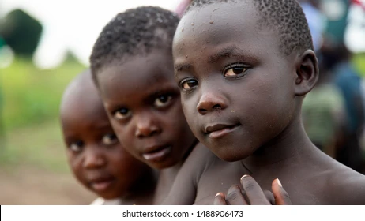

SESSION
What are children’s rights?
Notes:
1. EWAD will identify a Child Rights Specialist to facilitate this session

Slide 38

CHILD RIGHTS LENS
What is
a child?
VIDEO:
https://www.youtube.com/watch?v=COjVj9czgrY
Notes:
Find a Video on Uganda.
1. Incorporate Videos from Karamoja and Busia. E.g., when celebrating Child labour day, have videos of children. Margaret will link us to the Communication department EWAD – Action to Sharon

Slide 39
CHILDREN’S RIGHTS
Food
Cultural Activities
Life
Water
Play
Education
SURVIVAL
DEVELOPMENT
Health
Sanitation
Standard of Living
Medical Care
Recreation
BUSINESS CAN
IMPACT ON
THESE RIGHTS
Views
Discrimination
Violance
Abuse
Listen to children
Detention
Juvenille justice
PARTICIPATION
PROTECTION
Children in armed forces
Sexual Exploitation
Role in society
Refugees
Opinion
Conflict

Slide 40
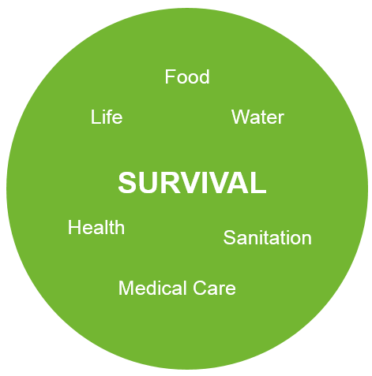
BUSINESS CAN
IMPACT ON
THESE RIGHTS

Slide 41
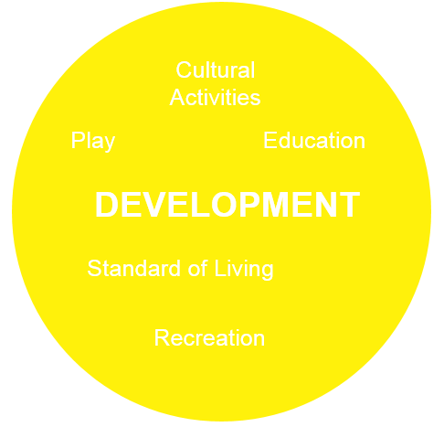
BUSINESS CAN
IMPACT ON
THESE RIGHTS

Slide 42
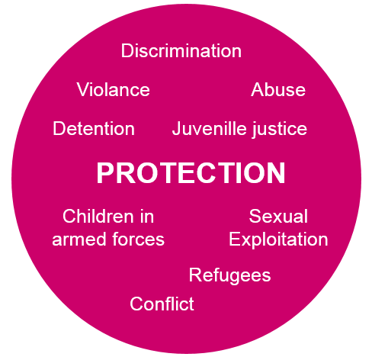
BUSINESS CAN
IMPACT ON
THESE RIGHTS

Slide 43
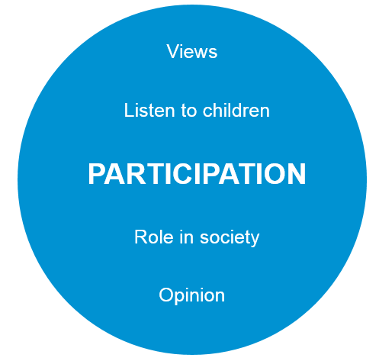
BUSINESS CAN
IMPACT ON
THESE RIGHTS

Slide 44

HEALTH Break

Slide 45

CRBP kiosks
VIDEO: https://www.youtube.com/watch?v=3NC5i8c3Qz4
Plenary activity
Notes:
Look at local videos

Slide 46
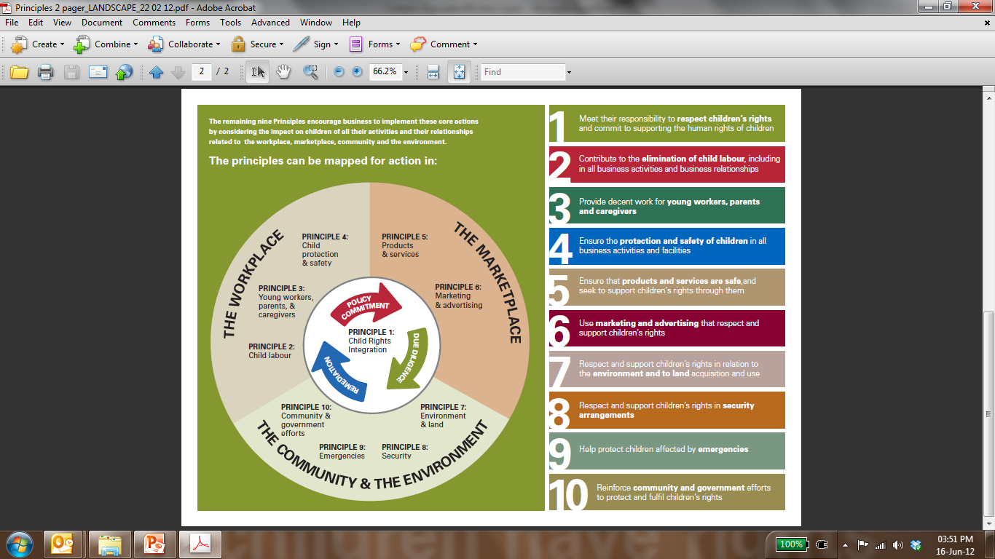

The UN Global Compact asks businesses to support and respect the protection of internationally proclaimed human rights
  Respect – do not cause harm
  (the minimum)
  Support – make a positive contribution
  (desirable, encouraged)
The Principles elaborate on what this means as regards Children’s Rights…
Notes:
Richard – Community and Environment
Shallon – Workplace

Slide 47
Lunch break

Slide 48

SESSION
01
ASSESS CURRENT MINING COMPANIES’ IMPACTS

Slide 49
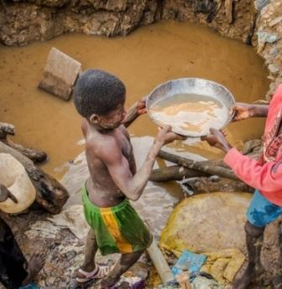
ASSESS PRIVATE SECTOR IMPACTS 🡺
Resettlement
In-Migration
Environment
Security
Health and Safety
Working Conditions
Sexual violence
Social Investment
Stakeholder Engagement
Impact Assessment

Slide 50
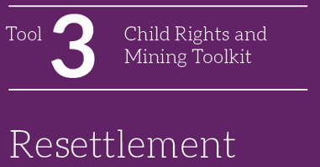
Resettlement Goal:
Enable people who are displaced by a project to improve their standard of living
Requires:
Socio-economic baseline
Compensation framework
Collaboration with local government
Impacts on Children:
Are psychologically more vulnerable to change
May be discriminated against in accessing compensation
Vulnerable children (heads of households, orphans, children living or working on the streets) may not have property rights, and/or suffer from discrimination in access to compensation and remedy.

Slide 51
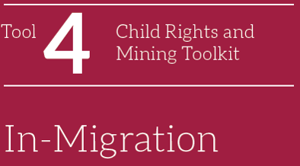
Goal:
Managing in-migration will take account of ‘controlled’ and ‘uncontrolled’ arrivals of many types of people.
Requires:
Working with local authorities on registration of migrant job seekers
Project footprint and infrastructure e.g., access roads etc.
Hiring policies
Operational models
Capacity building for local authorities
Operational models
Impacts on Children:
They live in receiving area/ returning with their families after previously living in the area/ are travelling with parents to a project area
They are left behind in a migrant-sending community while their parents or caregivers work at the mine or seek employment opportunities.

Slide 52
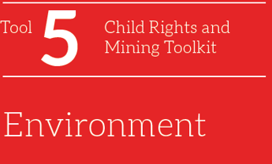
Goal:
Protect children from many of the environmentally related impacts of mining companies’ operations
Requires:
Assessing children’s health status and vulnerabilities
Focusing on children in studies of exposure to environmental pollutants
Considering neurobehavioural assessments to evaluate adverse health effects
Measuring the condition and trends of biodiversity in relevant ecosystems
Impacts on Children:
Water Quality
Dust
Land Cover
Threshold limit values
Safety
Toxicants

Slide 53
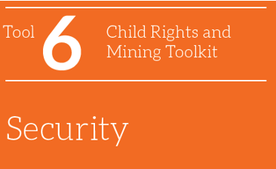
Goal:
Provide appropriate protection for the company, while also respecting and advancing the human rights of all stakeholders.
Requires:
Company policy for grievances
Private security management
Government security apparatus
Avoiding the use and employment of children in security
No child will be subjected to torture or other cruel, inhuman or degrading treatment or punishment.
No child will be deprived of her or his liberty unlawfully or arbitrarily. Every child deprived of liberty will be treated with humanity and respect for their inherent dignity.
Every child deprived of liberty has the right to prompt access to legal and other appropriate assistance

Slide 54
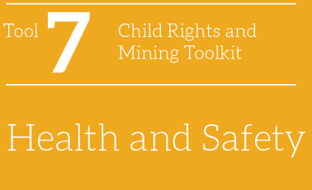
Goal:
Responsible for or complicit in violations of children’s rights through their approach to managing children’s health and safety at the site of operations and around it
Requires:
Managing on-site health and safety risks specific to children
Managing health and safety risks for children related to transportation infrastructure
On-site Health and Safety
Exposure to machinery, open pits, mine shafts, ponds, blasting and other aspects of mining operations.
Transportation and Infrastructure
New Roads and Railways

Slide 55
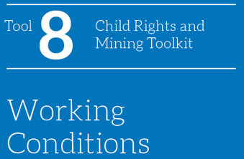
Goal:
Improve or positively affect children’s living conditions, well-being and development.
Requires:
Managing employees’ working hours, night shifts, commutes and fly in, fly out arrangements
. Avoiding discrimination against women and parents/caregivers
Managing working conditions of on-site contractors and related risks around child rights
. Managing employees’ exposure to hazardous materials
Managing employees’ wages, benefits and living conditions
Working hours, shifts and commutes
Discrimination against women or parents/ caregivers
Working conditions in the supply chain and management of on-site contractors
Hazardous materials and activities
Wages, benefits and living conditions
Labour and Working Conditions (2012): For any business, its workforce is its most valuable asset. A sound worker-management relationship is key to the success of any enterprise. PS2 asks that companies treat their workers fairly, provide safe and healthy working conditions, avoid the use of child or forced labour, and identify risks in their primary supply chain.

Slide 56
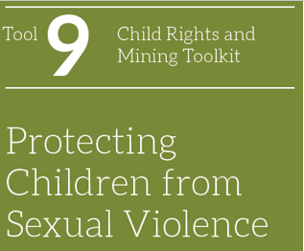
Goal:
The Convention on the Rights of the Child, article 34, states that children must be protected from “all forms of sexual exploitation and sexual abuse.”
Requires:
Protecting children from sexual violence through policies and systems
Addressing sexual violence related to business relationships
Addressing risks of sexual violence in surrounding communities
Poverty and deprivation, leading to child prostitution.
Changes in living conditions and the community landscape
High population density due to in-migration
Children living or working on the streets, near slums and night entertainment venues
Child labour
Lack of knowledge about sexual violence against children
Numerous workers and contractors present at the mining site and surrounding areas, particularly during construction
Low level of basic child protection and undermined rule of law in the country or area of operations

Slide 57
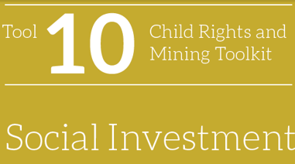
Goal:
Invest in children’s safety, education and health for more resilient and peaceful societies, and a sustainable future for the company
Requires:
Identification of child rights impacts at the planning phase
Designing a social investment strategy with a child rights perspective
Ineffective because:
Focuses too much on providing hard infrastructure -building schools, health clinics and other community facilities;
Is reactive, rather than strategic and proactive, failing to integrate into and align with long-term national, regional and local development plans
Is not connected to the mining operation’s impacts on child rights.

Slide 58
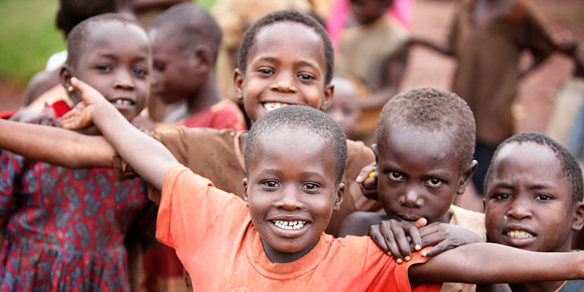
SESSION
02
ANALYSIS OF STAKEHOLDERS

Slide 59
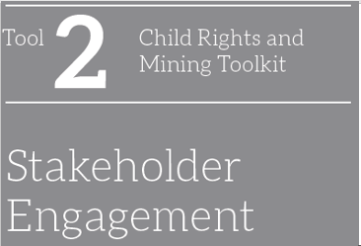
Youth Organizations
Civil Society and International Organizations
Academic Experts
Parents/ Caregivers
Government
Businesses/ Suppliers
Labour Organizations
Professionals in contact with children and/ or community leaders
Company Personnel
Children
Engagement techniques
Personal interviews, complaints and grievance mechanisms, workshops, focus groups/forums, public ‘town hall’ meetings, open days/open house meetings, comments/response sheets, surveys, participatory tools, and advisory committees/stakeholder panels

Slide 60
SESSION
03
SHOULD CHILDREN BE OUR BUSINESS?

Slide 61
THE CASE FOR busia/ karamoja

Slide 62
1. ISSUES IDENTIFICATION
2. ACTION PLANNING
3. Stakeholder endorsement

Slide 63
STAKEHOLDER ANALYSIS
Group Three – Policy makers
Community Group/ ASMs
Large Scale Mining Groups/ Associations
Policy makers
1. Stakeholder register validation
1. Stakeholder Influence Mapping
Endorse Stakeholders, their roles and influences
2. Stakeholder influence roles

